Slide 1

PRE-IDEATHON TEMPLATE
GENESIS
IDEATHON
TEAM & DOMAIN
Team Name –404: Sleep Not Found
Team Members – S Dheeraaj Khaan (CB.SC.U4CSE26242)
R Rohit (CB.SC.U4CSE26344)
Rebekah D Antony (CB.SC.U4CSE26241)
S Harini (CB.SC.U4CSE26243)
Selected Domain – Domain 6 ( Healthcare biotechnology and human well-being )
Problem Statement – Millions in under-resourced areas lack access to basic blood tests for conditions like anaemia due to high lab costs and missing medical infrastructure. Consequently, early-stage health issues go undiagnosed until severe complications arise.

Slide 2


DOMAIN PROBLEM IN OUR WORDS
TEAM
404: Sleep Not Found
In remote villages, many people already have early stages of long-term illnesses like anaemia , but nobody finds out. Detecting these early needs lab tests and trained staff, and the nearest lab can be far away and costly. So people reach a hospital only when the illness is already serious.
What exactly needs to be solved?
There is no cheap, easy way to screen for early warning signs in places without lab infrastructure . Screening should need no needles, expensive machines or specialists, only a smartphone-level tool that a local health worker can use.
Why is it important right now?
Conditions like anaemia are rising, and they are most dangerous when found late. Smartphones with decent cameras are now common in rural areas, and on-device machine learning is advanced enough for instant screening. Early detection lowers treatment costs and reduces the load on district hospitals.

Slide 3
WHO IS AFFECTED?
TEAM
404: Sleep Not Found
Target users, stakeholders, beneficiaries
Primary users / target group
Rural and low-income populations in remote areas without local diagnostic labs.
Pregnant women, infants, and elderly individuals at high risk for anaemia .
Secondary stakeholders
Primary Health Centres (PHCs) and district hospitals who receive the referrals.
Clinicians, government health departments, NGOs, and village community leaders.
Who benefits if the problem is solved?
Patients: Get instant, painless, zero-cost screening before complications develop.
Healthcare System: Reduces overcrowding in district hospitals by filtering non-critical cases at
the village level

Slide 4
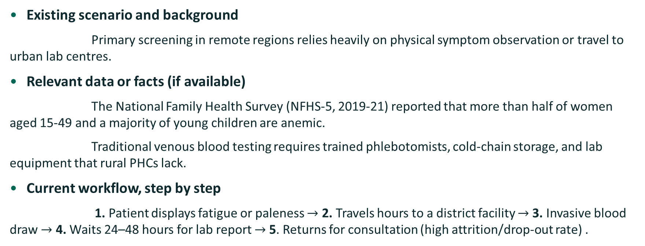
CURRENT SITUATION & CONTEXT
TEAM
404: Sleep Not Found
Existing scenario, background and how things work today
Existing scenario and background
Primary screening in remote regions relies heavily on physical symptom observation or travel to urban lab centres.
Relevant data or facts (if available)
The National Family Health Survey (NFHS-5, 2019-21) reported that more than half of women aged 15-49 and a majority of young children are anemic.
Traditional venous blood testing requires trained phlebotomists, cold-chain storage, and lab equipment that rural PHCs lack.
Current workflow, step by step
1. Patient displays fatigue or paleness $→$ 2. Travels hours to a district facility $→$3. Invasive blood draw $→$ 4. Waits 24–48 hours for lab report $→$5. Returns for consultation (high attrition/drop-out rate) .

Slide 5
KEY CHALLENGES
TEAM
404: Sleep Not Found
Main difficulties, bottlenecks, root causes and consequences
Main difficulties and bottlenecks
High out-of-pocket costs for diagnostic tests and transportation.
Patient fear/avoidance of invasive needle pricks during routine checkups
Root causes behind them
Centralized diagnostic infrastructure that fails to reach rural last-mile areas.
Severe shortage of certified lab technicians in rural health centres.
Consequences of leaving them unsolved
Delayed diagnosis leads to preventable severe anaemia, organ damage, or neonatal complications.
Increased long-term healthcare expenditure for families and government health funds

Slide 6
PROBLEM INSIGHTS & OPPORTUNITY AREAS
TEAM
404: Sleep Not Found
Resources required to solve the problem
Hardware Requirements
  Android smartphone with camera and flash. Printed colour reference card. Power bank for field use.
Software Requirements
Android app with guided image capture and local-language support. On-device ML model for anemia and jaundice risk. Offline storage with auto-sync. Web dashboard for PHCs to track referrals. Encrypted, consent-based data handling.
Other resources (Including Human Resources)
ASHA/ANM health workers with brief training. Clinicians and a partner lab for validation. ML engineer and app developer. A diverse labelled image dataset. Ethical approval and funding support.

Slide 7
EXISTING SOLUTIONS / APPROACHES
TEAM
404: Sleep Not Found
What is already being done, and where it falls short
Existing methods, systems or alternatives
Lab blood tests, finger-prick hemoglobin devices, research-stage smartphone eyelid-photo apps, and health camps with telemedicine.
Limitations of each
Labs are far, costly and slow; finger-prick kits are invasive; existing apps need controlled lighting or trained users and are weaker for mild cases; camps and telemedicine are periodic and connectivity-dependent.
The gap they leave open (Key Challenges)
Existing research shows eyelid photos can screen for anaemia, but most tools need controlled lighting, trained users or special accessories.

Slide 8
INITIAL DIRECTION & EXPECTED OUTCOME
TEAM
404: Sleep Not Found
What Is Your Expected Outcome?
What your team intends to do
We will build a low-cost, offline smartphone tool that lets health workers screen for anaemia from lower-eyelid photos using on-device ML, and refer flagged people for a confirmatory blood test, starting with a small clinical pilot.
What you want to improve
Accessibility, speed, and comfort of primary health screening in off-grid environments.
What successful improvement should you achieve
High agreement with lab results. More people screened per health worker. More cases caught early and fewer late-stage emergencies. Most flagged people reaching confirmatory tests. Much lower cost per screening.

